Slide 1
Grief, Trauma Informed Care & Compassion Fatigue
June 9, 2022
1:00 PM EDT
Webinar
Notes:
Introductions: Whitney speaks; Beverly speaks (brief statement about the organization); Jill speaks (greetings and brief statement about the organization; introduces Gen); Gen speaks (introduces herself further)

Slide 2
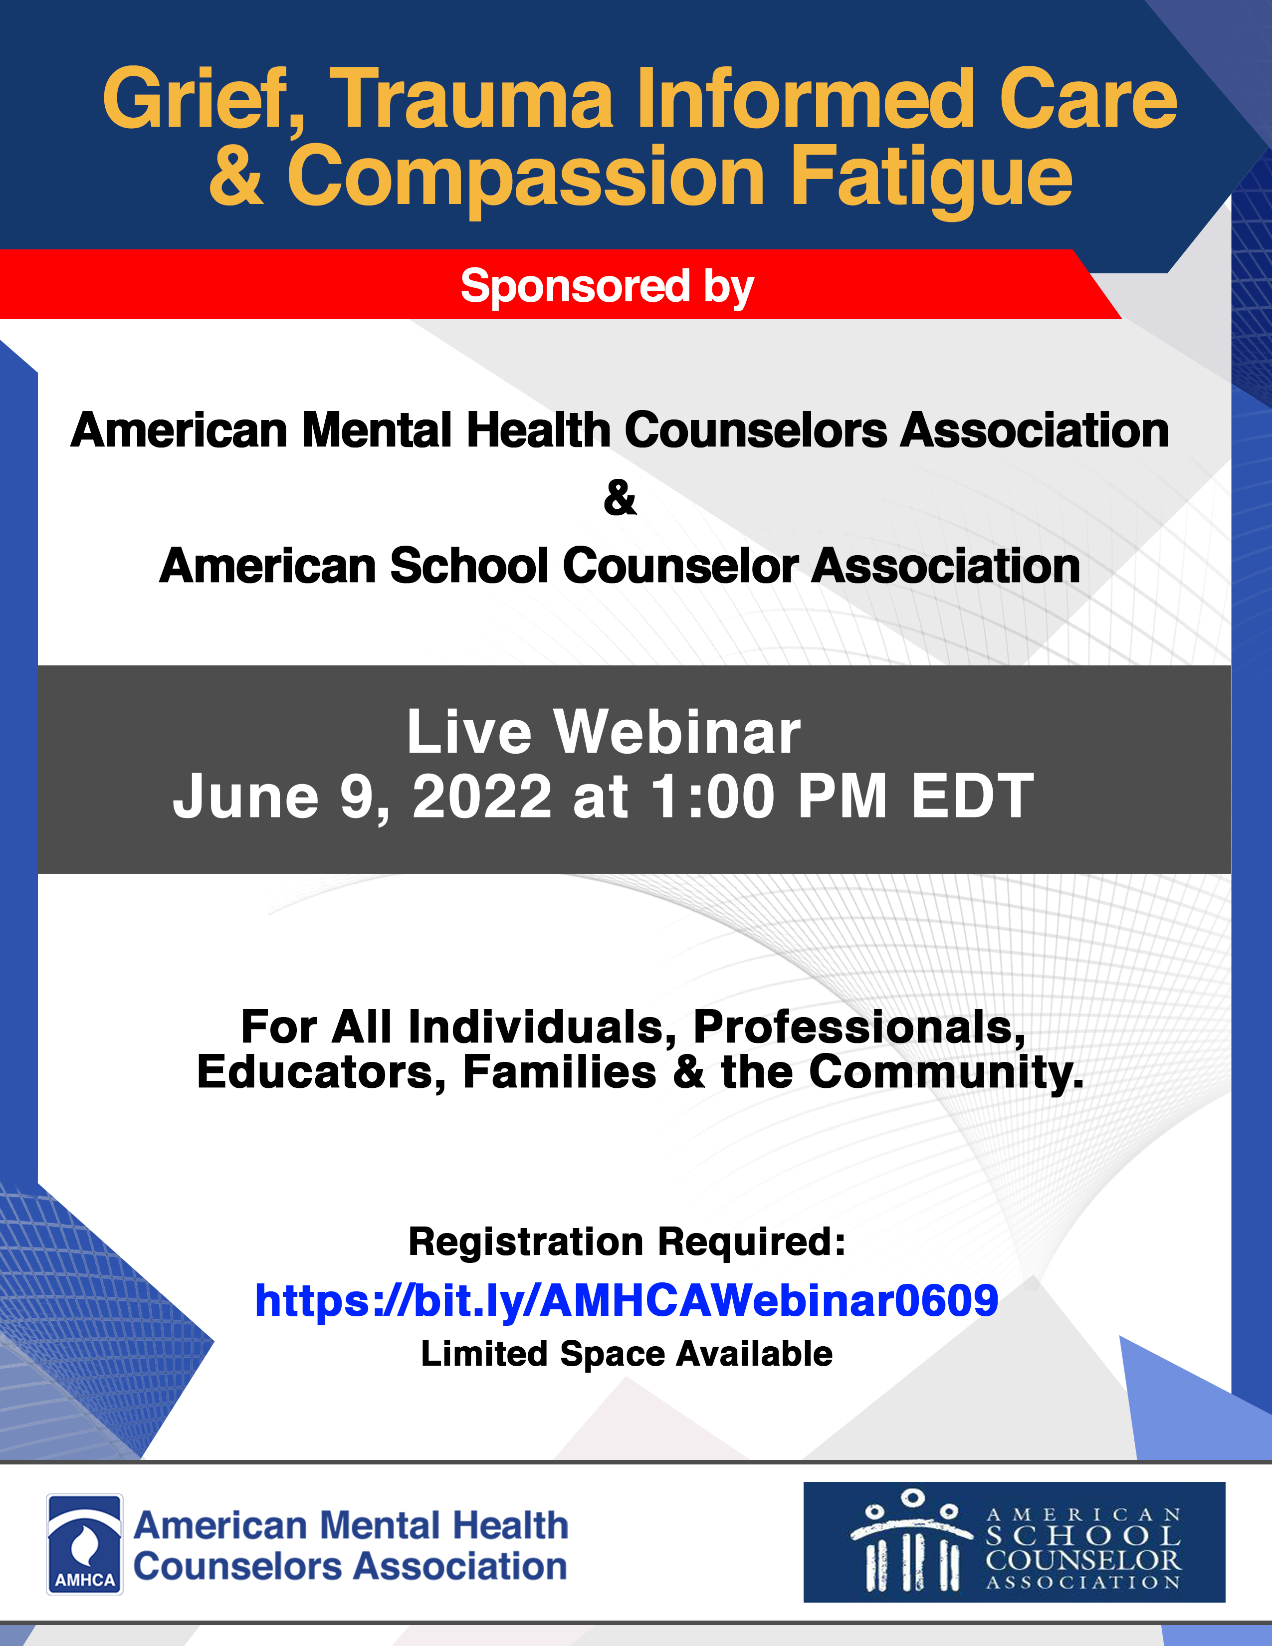
Notes:
Beverly

Slide 3
Grief and loss are a part of our current realities with the tragedies of mass shootings in our societies.
Therefore, an organizational collaboration with AMHCA and ASCA is for the purpose being a resource for helping to understand grief, a resource for encouragement and a resource for practical coping strategies for Post-traumatic Growth.
Notes:
Jill or Beverly

Slide 4
Objectives
Increase the awareness of the grief process, trauma, & compassion fatigue
Increase the knowledge of tools for enhanced coping strategies and skills
Expand competencies for self-balance & renewal
Notes:
Beverly

Slide 5
Post in the chat a word or phrase that best describes your current being, feelings and thoughts and/or actions in relations to the tragedies of mass shootings.
Notes:
Beverly

Slide 6
Centering
Notes:
Beverly

Slide 7
Processes of Grief
Shock and Denial
Pain and Guilt
Anger and Bargaining
Depression, Reflection, and Loneliness
Reconstruction and Working Through
Acceptance & Hope
Notes:
Beverly

Slide 8
…and the other steps
Discovery
Envisioning
Setting goals
Planning
Action
Notes:
Beverly

Slide 9
Types of Grief
Sudden Grief
Anticipatory Grief
Delayed Grief
“Normal Grief”
Disenfranchised Grief
Inhibited Grief, Absent Grief
Cumulative Grief
Notes:
Beverly

Slide 10
Complicated Grief
Homicide
Suicide
Traumatic death
Turbulent relationship with the deceased
COVID19
“Complicated grief is like being in an ongoing, heightened state of mourning that keeps you from healing.”
The Mayo Clinic
Notes:
Gen

Slide 11
Prolonged Grief Disorder
New, controversial diagnosis in the DSM V-TR
Diagnostic Criteria (need 3, daily):
Identity disruption (feeling as though part of you has died)
Sense of disbelief about the death
Avoidance of reminders that the person is dead
Intense emotional pain related to the death (anger, bitterness, sorrow)
Difficulty reintegrating/”moving on” into one’s relationships and activities (socializing with friends, pursuing interests, planning for the future)
Emotional numbness
Feeling that life is meaningless
Intense loneliness
The duration & severity of bereavement reaction clearly exceed expected social, cultural, or religious norms
And…
For adults, the death was 12 months ago or more
For children, the death was 6 months ago or more
Notes:
Gen

Slide 12
Stats
1 in 13 children in the US will experience the death of a parent or sibling by age 18.
Bereaved children rate grew from 7.3% in 2015
to 7.7% in 2020
7.7% = 5.6 million children
Number of adult deaths increased 39% from 2015
Childhood Bereavement Estimation Model (CBEM), Judi’s House
Notes:
Gen

Slide 13
Trauma
Trauma creates change you don’t choose.
Healing is about creating change you do choose.
Michele Rosenthal
Notes:
Beverly

Slide 14
Trauma
Psychological & Physiological responses someone has to an negative event
Perceived threat or danger
Normal reaction that may interfere with life functioning
Sources (natural, deliberate, accidental, medical)
Pandemics
Domestic violence
Natural disasters
Severe illness or injury
The death of a loved one
Witnessing an act of violence
Notes:
Beverly

Slide 15
Trauma
Violation of the integrity of self
Directly or Indirectly
Repeated or extreme exposure
Relational
Pre-birth, Life Long
Childhood
Adulthood Manifestation
Memory Loss
Dissociative Symptoms
Numbing out the pain
Protective Factors:
Ethnicity
Geographical
Socio-economics
Education
History
Religion
Spirituality
Family of origin
General experiences
Notes:
Beverly

Slide 16
Trauma
Shared Trauma
Historical Trauma
Transgenerational Trauma
Complex Trauma
Post-Traumatic Stress Disorder
Notes:
Beverly

Slide 17
PTSD
DSM-5 TR PTSD Overview (6 and Up)
Exposure to actual or threatened death, serious injury or sexual violence in one of the following:
Direct experiencing, Witnessing, Learning, experiencing repeated or extreme trauma
Presence of one or more intrusion symptoms associated with the traumatic event(s)
Persistent avoidance of stimuli associated with the traumatic event(s)
Negative alterations in cognitions and mood associated with the traumatic event(s)
Marked alterations in arousal and reactivity associated with the traumatic event(s)
Duration of the disturbance (Criteria B, C, D and E) is more than one month
Disturbance causes clinically significant distress or impairment in social, occupational or other important functioning
Disturbance is not attributed to the physiological effects of a substance or other medial condition
Notes:
Beverly

Slide 18
Signs & Symptoms of Grief
Emptiness, loneliness or isolation
Weight loss or gain
Digestive problems
Poor sleep, Poor focus
Unhealthy decisions
Risky behaviors
Clingy, Crying, Exaggerated fears
Work or school problems
Numbness
Bodily aches or pains
Low energy or fatigue
Mood swings
Anger
Feelings of injustice
Guilt
General & Identity Confusion
Bed-wetting (adults & kids)
Notes:
Gen & Beverly

Slide 19
Theories of Grief
David Kessler
We are servers, not helpers/fixers. Fixers implies that others are broken.
Worked and published with Elizabeth Kubler-Ross
6th “stage” of grief - Finding Meaning
No timeline for grief, but a range:
Anticipatory grief (prior to death)
Acute
Early (first 2 years)
Mature
Mourning is what we see on the outside, grief is what happens on the inside
Can’t see grief, but can see acts of mourning
Notes:
Gen

Slide 20
Theories of Grief
J. William Worden’s Task-Based Model
Task 1: Accept the reality of the loss
Task 2: To process the pain of grief
Task 3: To adjust to a world without the deceased
Task 4: To find an enduring connection with the deceased in the midst of embarking on a new life
Notes:
Gen

Slide 21
Hope Edelman’s Rings of Grief
Growth
Elements not stages
Proxy grief
grieving on behalf of the deceased during events they won’t get to experience.
Active Grief
Notes:
Gen

Slide 22
COVID-19
Stigma
Inability to see loved one prior to death, or be with them while in medical care
Services/funerals
Lack of emotional and physical connectivity due to restrictions
Isolation in grief
Increase in needs for adult groups (death of older adults)
Notes:
Gen

Slide 23
Secondary Loss
Loss of
traditions
Move out of home
Loss of shared memories
Death
New school
Change in guardianship
Notes:
Gen

Slide 24
Common Misunderstandings in Grief
Language:
Responses that involve “moving on,” or “finding closure” are disconnecting.
“Passed away” or “lost” vs. “Died”
Terminology around suicide
We shy away from talking about it
Grief reminds us we’re vulnerable and not immune to death, loss, and hurt.
It is “easier” to blame, escape, or distance ourselves
We often search for reasons or excuses
We disconnect to protect ourselves
We fear not finding a reason for the death/event, because a reason differentiates between what happened and the possibility of it happening to us.
Notes:
Gen

Slide 25
Common Misunderstandings in Grief
We put a timeline on it
“Stages” of grief are not linear
Kubler-Ross’ 5 stages were not designed for all grief
We use a solution-focused approach
“What can I do?” (How can I fix it?)
There is not an “end” to the grief journey, there is not a point at which grief is “fixed.”
We must bear witness.
Notes:
Gen

Slide 26
Understanding Acceptance is NOT
Giving Up
Giving In
Surrendering
Tolerating
Failing
Being Defeated
Ignoring your thoughts and feelings
Notes:
Beverly

Slide 27
Embracing Acceptance is…
Opening up
Allowing
Leaning in
Breathing into
Creating space
Expanding
Being willing
Releasing the struggle
Embrace Your Mind, Body & Soul
Notes:
Beverly

Slide 28
Compassion Fatigue (CF)
Exposure to a traumatized individual rather than from exposure to the trauma itself
Compassion Fatigue perceived as the intersectionality between secondary traumatic stress (STS) and burnout (BO)
Notes:
Beverly

Slide 29
Compassion Fatigue (CF)
Burnout is cumulative stress from the demands of daily life, a state of physical, emotional, and mental exhaustion as a result of not being able to cope with one’s environment.
Compassion Fatigue addresses the relational nature of the condition.
Burnout informs of environmental stressor.
Notes:
Beverly

Slide 30
Compassion Fatigue
Burnout
Compassion Fatigue
Secondary Trauma
Notes:
Beverly

Slide 31
Compassion Fatigue Characteristics
Exhaustion
Anger
Irritability
Negative coping behaviors
Reduced ability to feel sympathy and empathy
Diminished sense of enjoyment or satisfaction
Impaired ability to make decisions
Impaired ability to care for others
Figley, 2002
Notes:
Beverly

Slide 32
Compassion Fatigue Predictive Variables
Empathic Ability
Empathic Concern
Exposure to the Client
Empathic Response
Compassion Stress
Sense of Achievement
Disengagement
Prolonged Exposure
Traumatic Recollections
Life Disruption
Figley, 2002
Notes:
Beverly

Slide 33
Navigating Grief, Loss & Trauma
Reconnect With What Is Important
Embrace Your Thoughts & Feelings
Growing With & Without Pain
Notes:
Beverly

Slide 34
How do we help?
No “right” way to grieve
Not all people cry openly
Siblings grieve the same person differently
Major life events may trigger a new wave of grief.
They need people they can talk about their person with - say their name out loud, share memories, openly grieve.
First year vs. second year
“The anniversary is merely one day; it is not the culmination of grief.” - Brandy Lidbeck
Some fear that the “end” of intense grief means the end of their relationship with the deceased.
Offer choices as much as possible - there is very little control in death & grief.
Notes:
Gen

Slide 35
You are bigger than your sadness
Journal Writing
Self-Monitoring
Positive Self-Talk
Create a Collage or Other Memorials
Establish routines for mental care
Growing With & Without Pain
Notes:
Beverly

Slide 36
Post-Traumatic Growth
Reconfiguration & Restoration
Accept
Affirm
Persevere
Build
Explore
Offer
Begin
Domains of PTG:
New possibilities
Personal strength
Relating to others
Appreciation of life
Spiritual change
Notes:
Beverly

Slide 37
Post-Traumatic Growth
Forgiveness is not an occasional act,
it is a permanent attitude.
Rev. Dr. Martin Luther King, Jr
Notes:
Beverly

Slide 38
Recommended Reading
It’s Okay that You’re Not Okay by Megan Devine
Finding Meaning by David Kessler
The After Grief by Hope Edelman
The Gift of Second by Brandy Lidbeck
The Body Keeps the Score by Bessel van der Kolk, MD
A Mother’s Reckoning: Living in the Aftermath of Tragedy by Sue Klebold
Picture Books:
Tear Soup by Pat Schwiebert
Little Grievers by Sarah Brown & Nannette Thomas
The Rabbit Listened by Cori Doerrfeld
Ida, Always by Caron Levis
Grief is Like a Snowflake by Julia Cook
The Invisible String by Patrice Karst
Notes:
Gen

Slide 39
Be patient towards all that is unsolved in your heart and try to love the questions themselves… Live the questions in the now. Perhaps you will gradually, without noticing it, live along some distant day into contentment.
Author unknown

Slide 40
References
Bride, B., Radley, M., & Figey, C. (2007). Measuring Compassion Fatigue. Clinical Social Worker Journal, 35, 155–163
Earley, J. (2009). Self-Therapy: A step-by-step guide to creating wholeness and healing your inner child using IFA, a new, cutting-edge psychotherapy (2nd ed.). Larkspur, CA: Pattern System Books.
Engle, D.E., & Arkowitz, H. (2006). Ambivalence in psychotherapy: Facilitating readiness to change. New York: Guilford.
Figley, C.R. (2002). Treating compassion fatigue. New York, NY: Brunner-Routledge.
Hall, K., Barden, S., & Conley, A. (2014). A relational-cultural framework: Emphasizing relational dynamics and multicultural skills development. The Professional Counselor 4, 71-83.
Kubacky, G. (2019). Moving through grief: Proven techniques for finding your way after loss. Emeryville, CA: Rockridge Press.
Maslach, C., & Leiter, M. (1998). The truth about burnout: How organizations cause personal stress and what to do about it. San Francisco, CA: Jossey-Bass.
Murphy, S. N. (2015). Motivation to change. Counseling Today, 57(11), 39-44.
Managing Stress & Relaxation Skills. www-nehc.med.navy.mil/hp/stress
Rock, D. (2011, June 2) Introducing the healthy mind platter. Announcing the healthy mind platter. Psychology Today. https://www.psychologytoday.com/us/blog/your-brain-work/201106/announcing-the-healthy-mind-platter
Warner, J. (2018). Grief: Day by day simple practices and daily guidance for living with loss. Emeryville, CA: Althea Press

Slide 41
References
Earley, J. (2009). Self-Therapy: A step-by-step guide to creating wholeness and healing your inner child using IFA, a new, cutting-edge psychotherapy (2nd ed.). Larkspur, CA: Pattern System Books.
Engle, D.E., & Arkowitz, H. (2006). Ambivalence in psychotherapy: Facilitating readiness to change. New York: Guilford.
Hall, K., Barden, S., & Conley, A. (2014). A relational-cultural framework: Emphasizing relational dynamics and multicultural skills development. The Professional Counselor 4, 71-83.
Kubacky, G. (2019). Moving through grief: Proven techniques for finding your way after loss. Emeryville, CA: Rockridge Press.
Murphy, S. N. (2015). Motivation to change. Counseling Today, 57(11), 39-44.
Managing Stress & Relaxation Skills. www-nehc.med.navy.mil/hp/stress
Warner, J. (2018). Grief: Day by day simple practices and daily guidance for living with loss. Emeryville, CA: Althea Press

Slide 42
Thank you
American School Counselor Association
American Mental Health Counselors Association
Notes:
Gen & Beverly (Q& A and closing words of encouragement and thanks)

